Slide 1
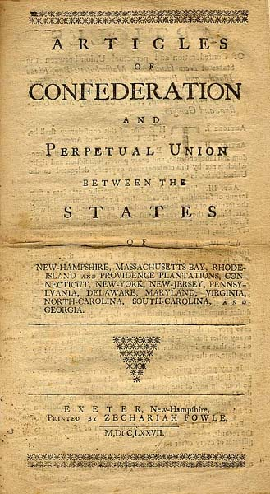
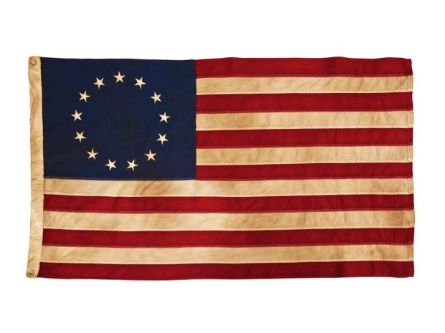
The Articles of Confederation

Slide 2
Forming a New Nation
The ties between the 13 colonies were as the roads that connected them.
People were looking for a that would unite all of the states effectively. The problem was the states had very little experience working together.
What is a central government??
Why is it important??
What things do you have, use, or value that the central government is responsible for??

Slide 3
State Constitutions
When forming a government, each state would typically write a constitution.
Two reasons for a constitution:
Each state had a similar constitution that would set out laws and regulations that fit them best. The power was split up between an executive and legislature.
The would execute or carry out the laws.
The would pass laws.

Slide 4
The Articles of Confederation
While states formed their own governments, the continental congress struggled to create a constitution for the whole nation.
Many were reluctant to give up any power to the central government.
Why?
The Continental Congress originally created the Articles of Confederation in 1777 and ratified(passed) it in 1781.
This document created a very loose alliance between the states.

Slide 5
Articles of Confederation
Under this document, the central government was treated like a subordinate to the state government.
was given little power because the people did not trust it or respect it thanks to .

Slide 6
Central Government Powers
Congress was the central government.
Group of selected state delegates who was in charge of foreign affair issues including:

Slide 7
Quick 5 Minute Assessment
Write a few sentences about why each colony wanted to give more power to state governments than the central government.

